Slide 1

DISCRIPTION
DUE TO THE CURRENT PANDEMIC IT IS IMPERATIVE THAT YOU ARE AWARE OF THE SITUATION EVERY COUNTRY IS FACING BEFORE TRAVEL.
THIS APPLACTION WAS BUILD TO HELP USERS SEARCH DIFFERENT COUNTRY ALL OVER THE WORLD WITH A FOCUS ON WEATHER, NEWS, MAPS, PANDEMIC AND SO MANY MORE.

Slide 2
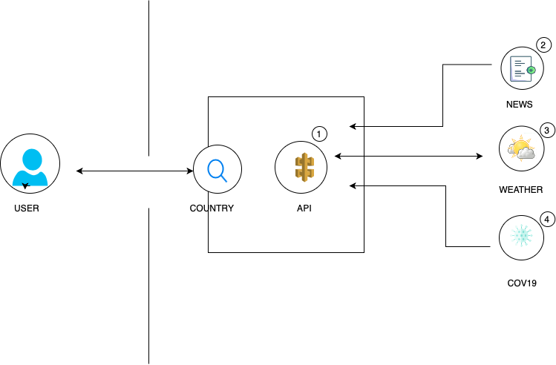
THE ARCHITECTURE
The user navigates to the site and search for a country
The API implemented then provider's the user with all the latest news, maps, videos, and weather of that county.
This App gives you the information you need to travel safely

Slide 3
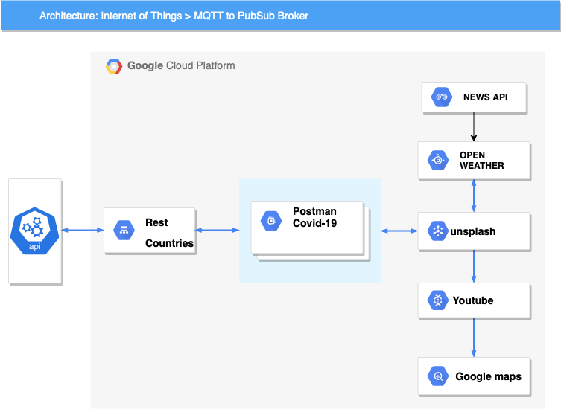
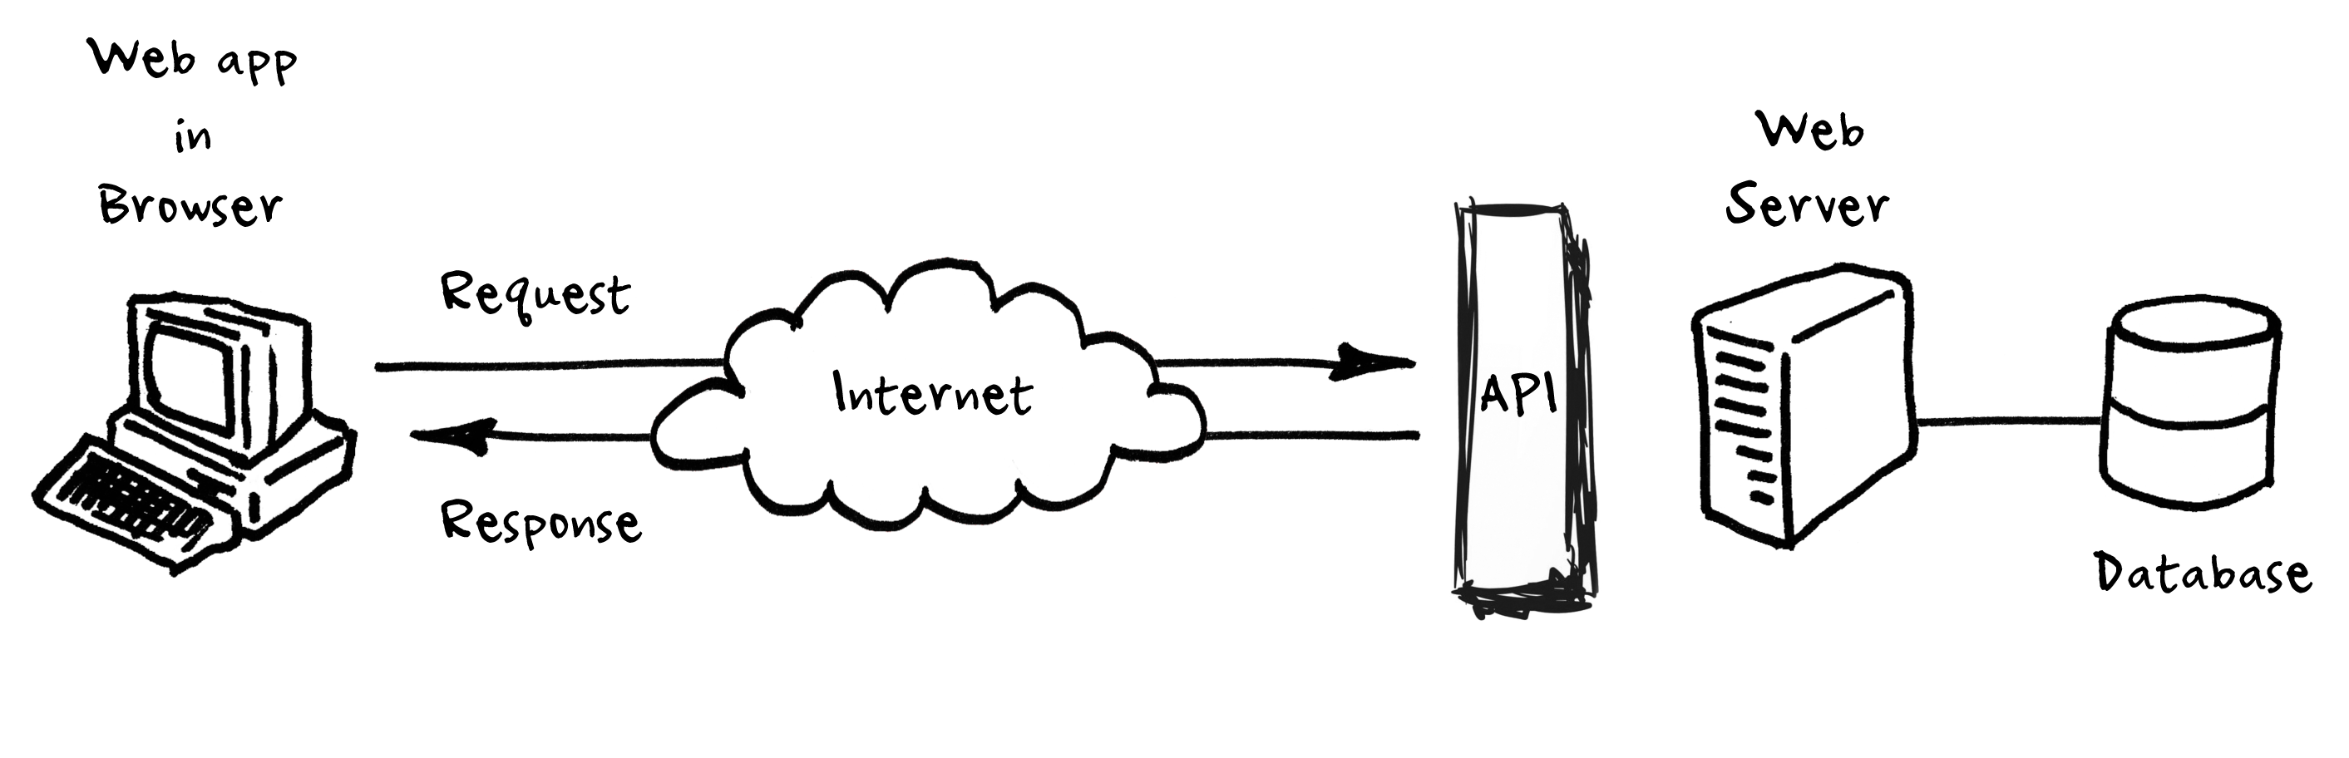
API UTILIZED

Slide 4

MASTER MIND
Hasan ertas
API
HTML
CSS

Slide 5

JONATHAN VIEIRA
TEAM LEADER
RESEARCH
API

Slide 6

KAMAL CARMICHARL
CSS
HTML
API

Slide 7

YETUNDE OLOKO
HTLM
POWERPOINT
READ ME

